Slide 1


Slide 2

OUTLINE
1.Executive Summary
2.Introduction
3.Methodology
4.Result
4.1.Charts
4.2.Dashboard
5.Conclusion

Slide 3
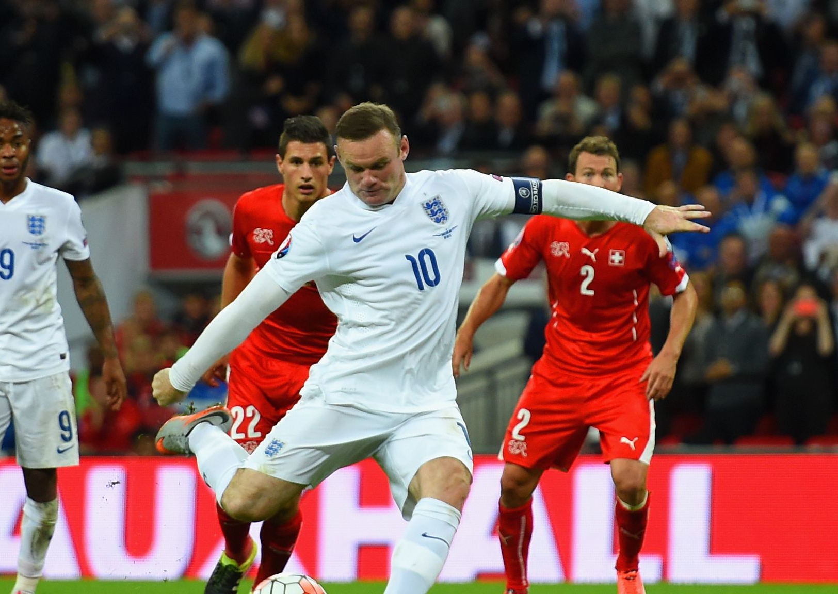
1.EXECUTIVE SUMMARY
Overview about football history from 1872-2021 (national team competitions, matches and goals)

Slide 4
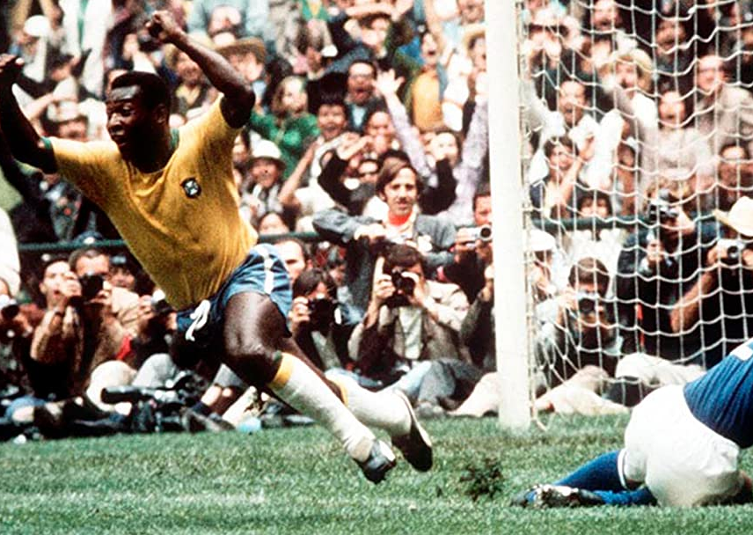
2.INTRODUCTION
Specify total matches, total goals, goals per match rate.
Percentage win, draw and lose between home teams and away teams.
The difference between football in the past and football nowadays.

Slide 5

3.METHDOLOGY
Data Collection
+ Collecting Data from Kaggle
Data Wrangling
+ Combine column using Concat (SQL)
+ Return values with specified conditions using Case statement (SQL)
- Exploratory Data Analysis
+ Analyze, explore data (using View)

Slide 6
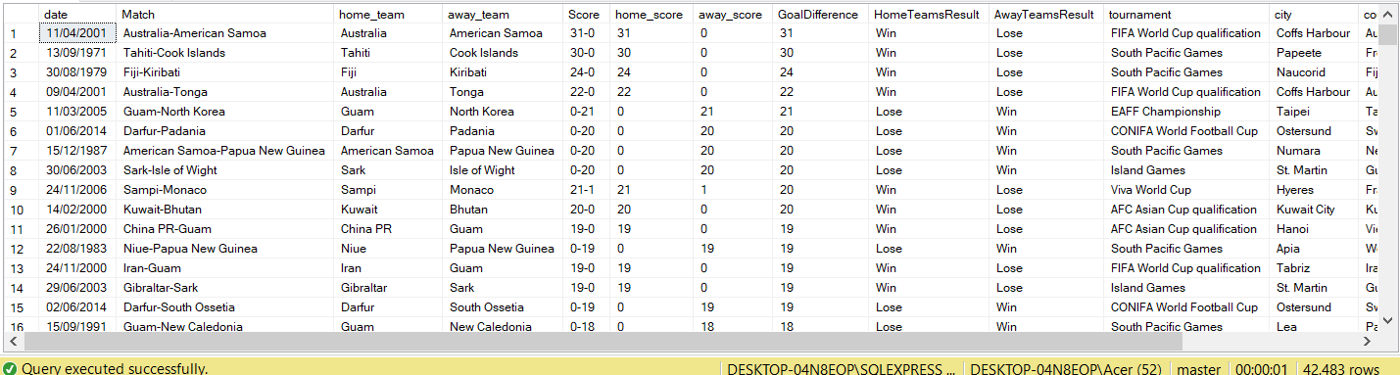
4.RESULT

Slide 7
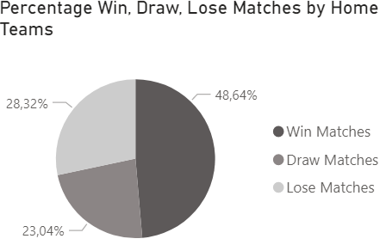
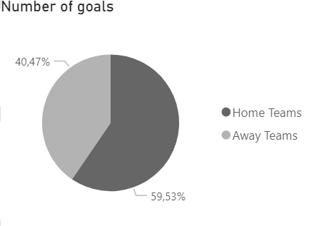
4.1.CHARTS
Through 42483 matches from 1872 to 2021, home team winning percentage is 48,64%. There are 59,53% goals from home teams and 40,47% goals from away teams.
It means that teams with home field advantage often play better and score more goals.

Slide 8
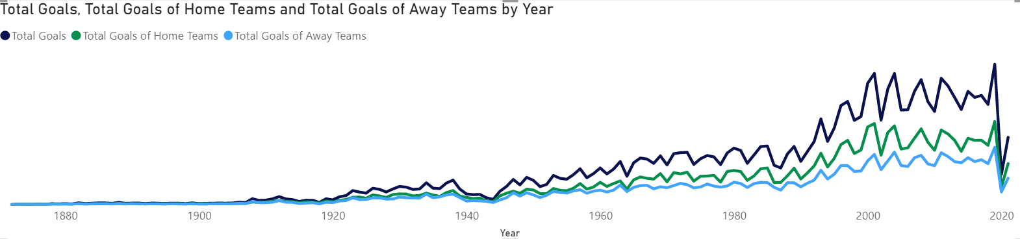
4.1.CHARTS
From 1872 to 2021, the total number of goals scored increased year by year. Home teams scored more goals than away teams. It shows that the matches in the past were often tight instead of as many goals as now.
Since 2020, because of Covid-19, the total number of goals decreased suddenly. Many competitions, matches were canceled. The players had to play with high intensity in order to finish the competition on time. It increased injury rates, declined their physical strength and scored less goals

Slide 9
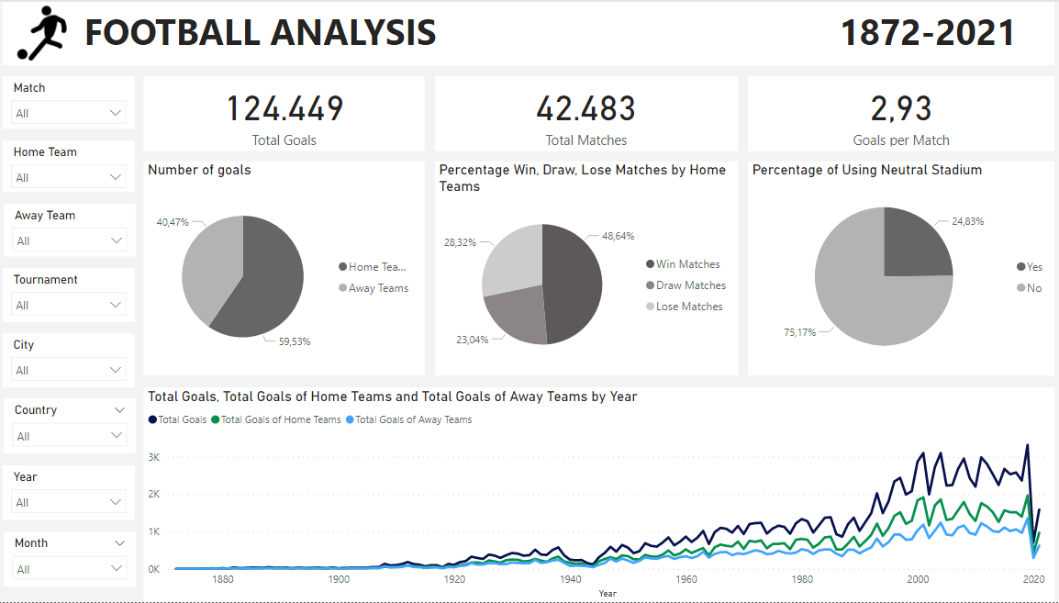
4.2.DASHBOARD

Slide 10
5.APPENDIX
Data link from Kaggle
https://www.kaggle.com/martj42/international-football-results-from-1872-to-2017

